Slide 1

PV fault detection
3 November 2020

Slide 2
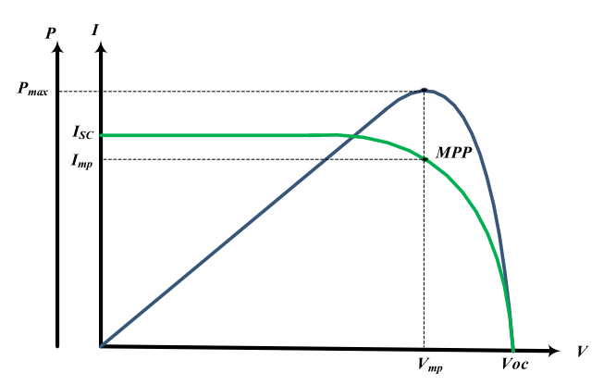
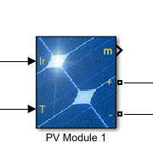
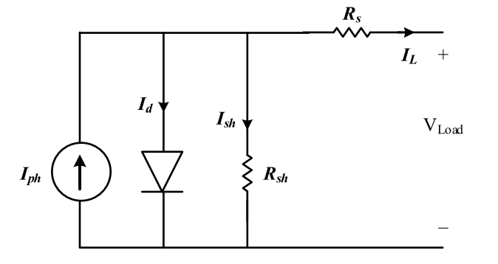
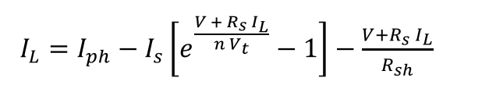
Background-PV model
PV model in Simulink
Equivalent circuit
I-V Curve of a PV module

Slide 3
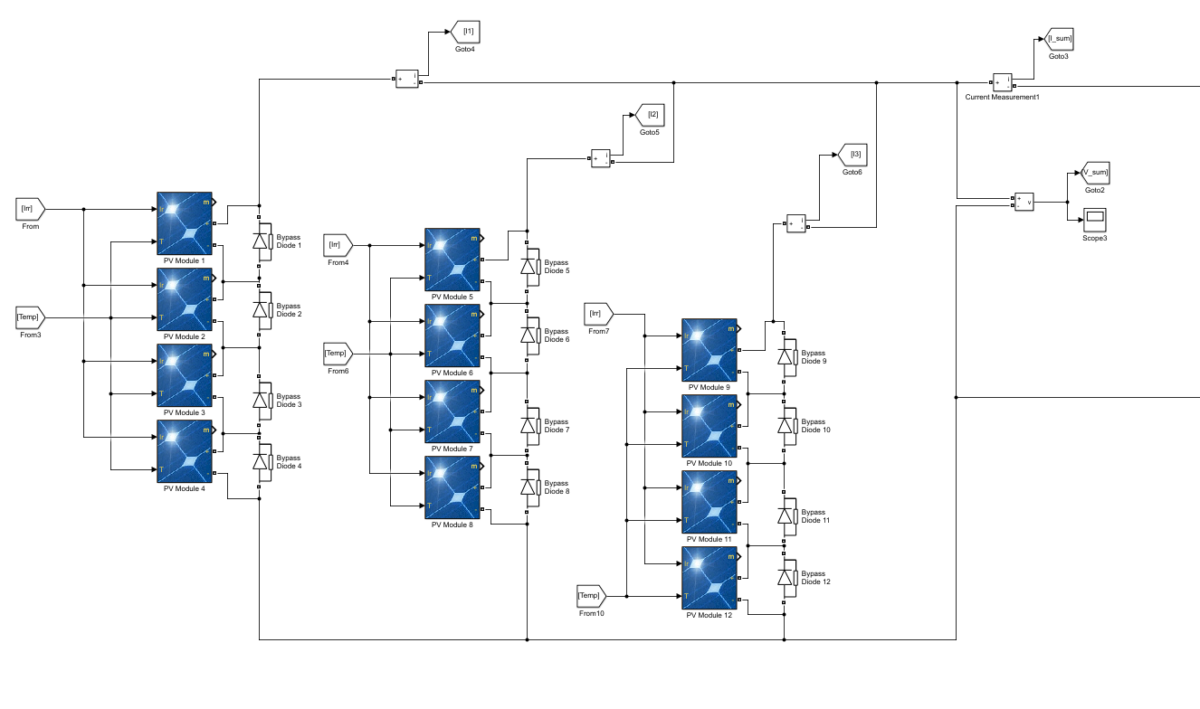
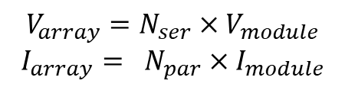
Background-PV model
$$V_{array}=N_{ser}×V_{module}$$
$$I_{array}= N_{par}×I_{module}$$

Slide 4
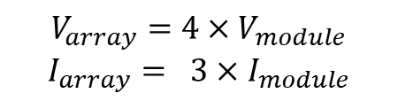
Background-PV model
$$V_{array}=4×V_{module}$$
$$I_{array}= 3×I_{module}$$

Slide 5
Background - PV fault types
Open circuit
Line to line short circuit
Line to ground short circuit
Partial shading fault (intermittent)

Slide 6
Motivation
PV data are difficult or expensive to obtain
The models are designed and trained only for certain PV installation

Slide 7
Objective
Single PV Data
PV array Data
Array information
NN classifier
NN classifier
Fault diagnosis

Slide 8
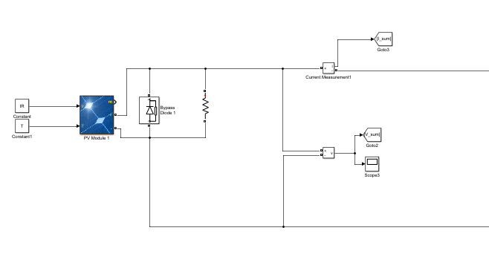
Single PV data
Normal
Short circuit
R = 0
R = 5
R = 10
R = 25
R = 1000
Open circuit

Slide 9
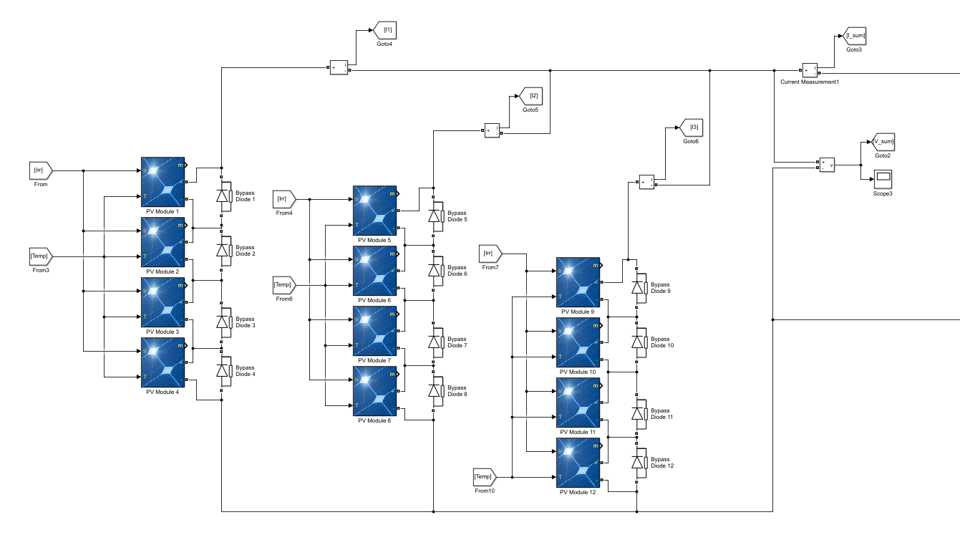

Array data 3x4
Normal
Short circuit
1 string 1/2/3 panel(s)
2 strings 1/2/3 panel(s)
Open circuit
String 1/2/3

Slide 10
Array data 10x9
Normal
Short circuit
1 string 1/4/8 panel(s)
2 strings 1/4/8 panel(s)
Open circuit
1 case

Slide 11
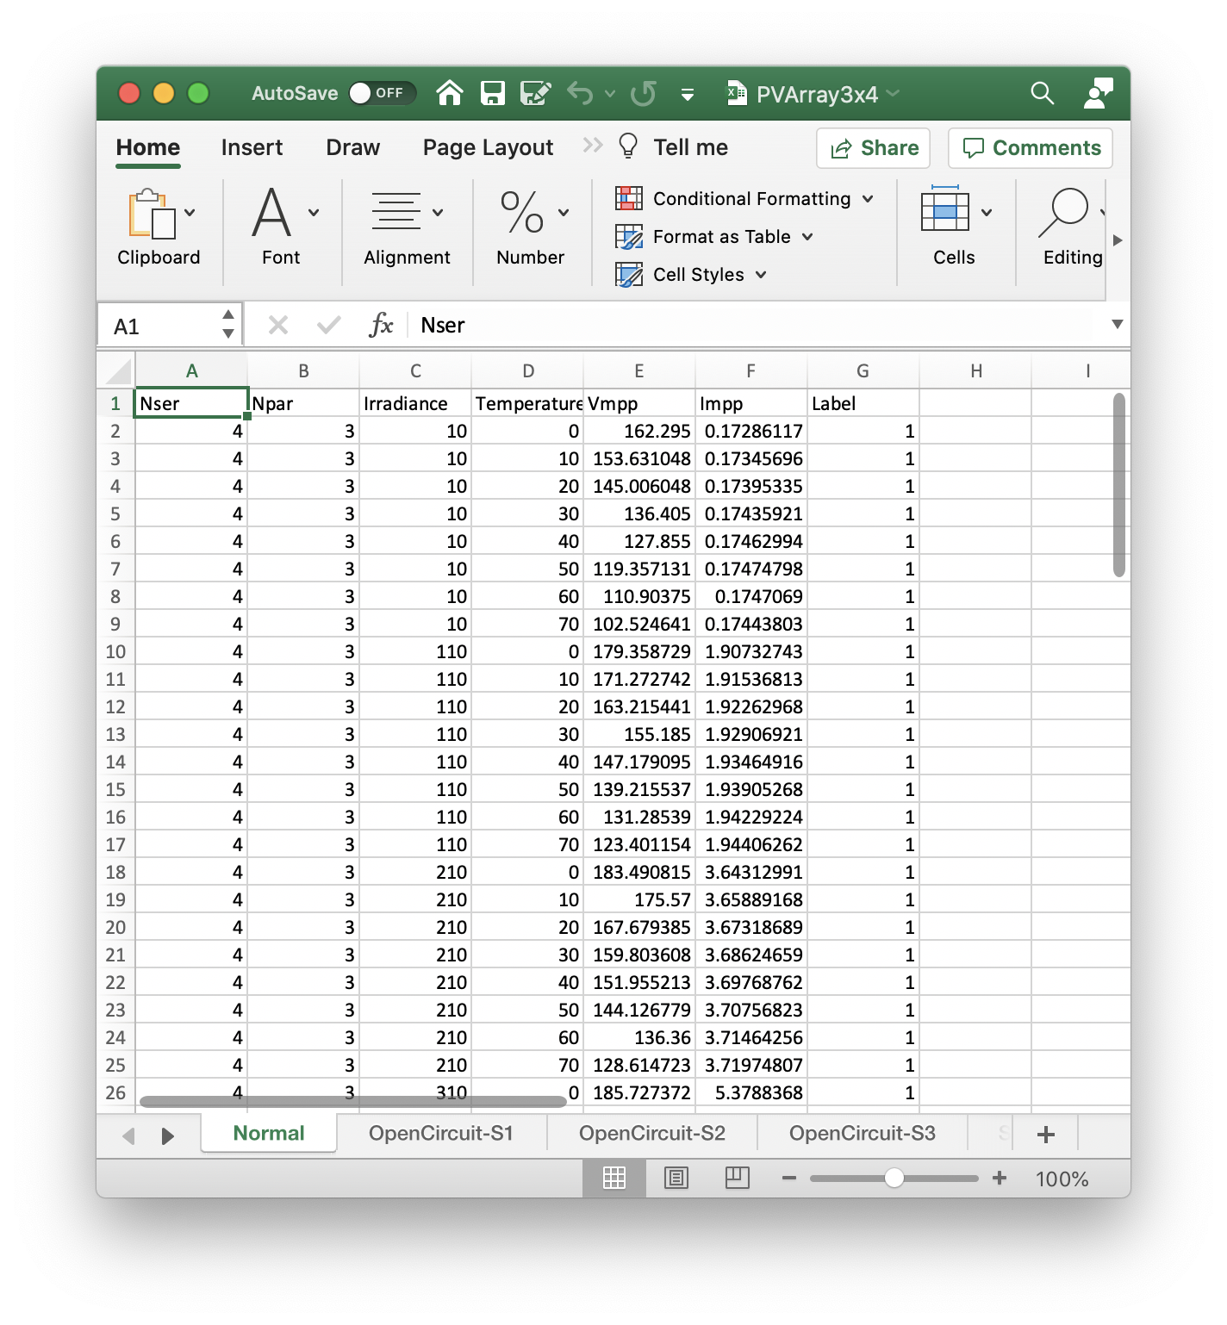
Data format
Nser
Npar
Vmpp
Impp
Label
Number of series-connected modules per string
Number of parallel strings
Voltage at maximum power point
Current at maximum power point
Fault type, 1-normal, 2-open circuit, 3-short circuit
Different cases

Slide 12

Thank you

Slide 13
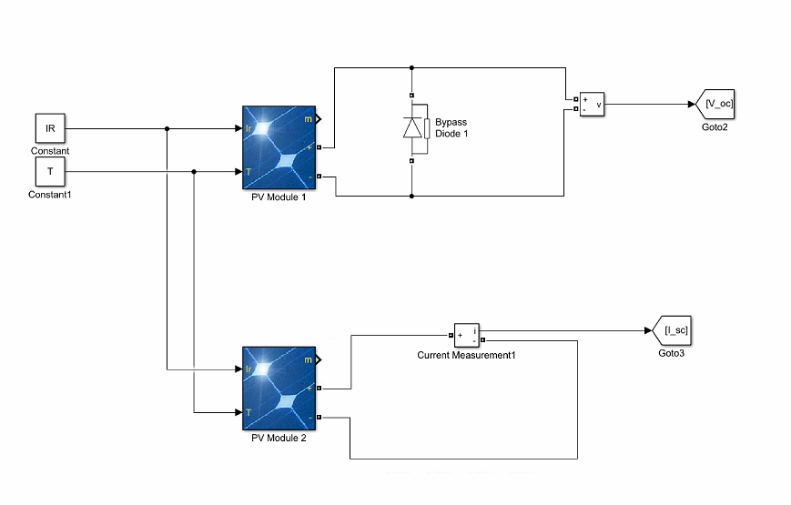
Additional data
Open circuit voltage
Short circuit current

